Slide 1
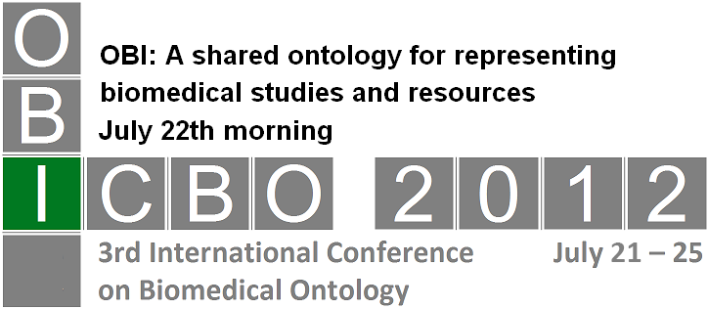

Ontology Development using OBI as a Source Ontology
Yongqun “Oliver” He
University of Michigan Medical School

Slide 2
Outline
You can rely a lot on OBI for development of new ontology, e.g., Vaccine Ontology (VO)
  How to align with OBI and use OBI to represent VO core terms
  How to apply OBI MIREOT strategy and the OntoFox tool to reuse existing OBI terms
  How to use OBI QTT procedure and the Ontorat tool to generate and annotate large numbers of new ontology terms

Slide 3
Outline
You can rely a lot on OBI for development of new ontology, e.g., Vaccine Ontology (VO)
  How to align with OBI and use OBI to represent VO core terms
  How to apply OBI MIREOT strategy and the OntoFox tool to reuse existing OBI terms
  How to use OBI QTT procedure and the Ontorat tool to generate and annotate large numbers of new ontology terms

Slide 4

Vaccine Ontology (VO)
VO: A biomedical ontology in the domain of vaccine and vaccination
Utilize the Basic Formal Ontology (BFO) as the top-level ontology.
Follow OBO Foundry principles, e.g., openness, collaboration, and use of a common shared syntax
Reference: Smith et al. (2007). The OBO Foundry: coordinated evolution of ontologies to support biomedical data integration. Nat Biotechnol 25 (11): 1251-5.
http://www.violinet.org/vaccineontology

Slide 5
Acknowledgement of Collaborations
VO is developed as a collaborative effort
My research lab at the University of Michigan
  Asiyah Yu Lin
  Allen Zuoshuang Xiang
  Yongqun “Oliver” He
Infectious Disease Ontology (IDO)
  Lindsay Cowell (UT Southwestern Medical Center)
  Barry Smith (U Buffalo, also BFO developer)
IAO: Information Artifact Ontology
  Alan Ruttenberg (also OBI developer)
OBI: Ontology for Biomedical Investigation
  Menalie Courtot (University of British Columbia, Canada)
  Bjoern Peters (La Jolla Institute for Allergy & Immunology)
  Richard H. Scheuermann (UT Southwestern Medical Center)
GO: Gene ontology
  Alexander Diehl (U Buffalo)
  Chris Mungall (Lawrence Berkeley National Laboratory)
Many others …

Slide 6
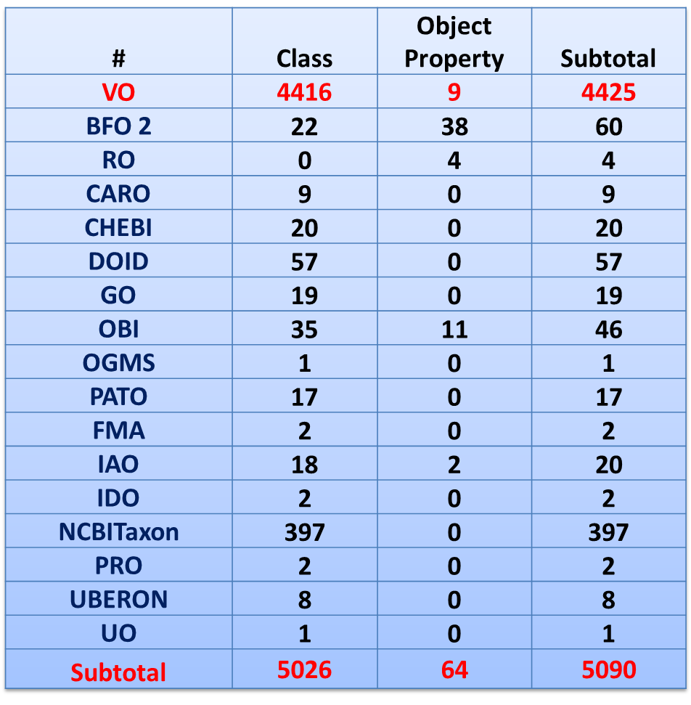
VO Statistics (as of July 19, 2012)
VO reuses
terms from other 16 ontologies
(how? See later demo)
VO includes >2000 vaccines for >20 host spp. against >100 diseases
(how? See later demo)

Slide 7
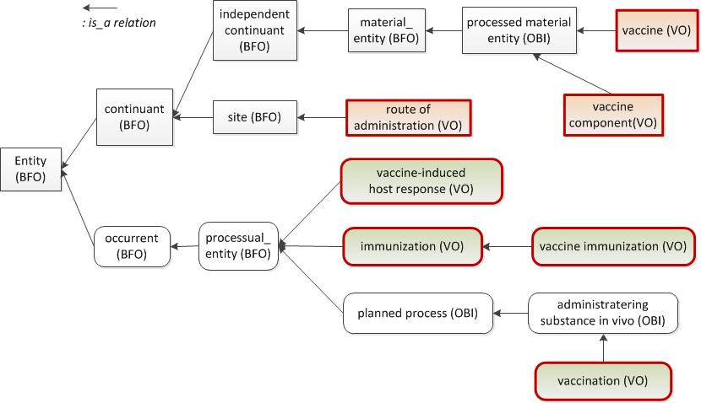
VO Core Term Hierarchy

Slide 8
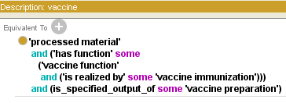

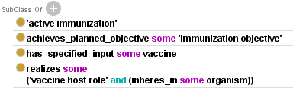
Define ‘vaccine’ in VO using OBI parent term
Definition: a OBI:processed material with the function that when administered, it prevents or ameliorates a OGMS:disorder in a target organism by inducing or modifying adaptive immune responses specific to the antigens in the vaccine.

Slide 9
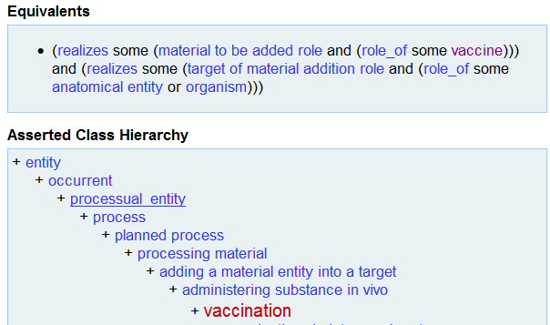
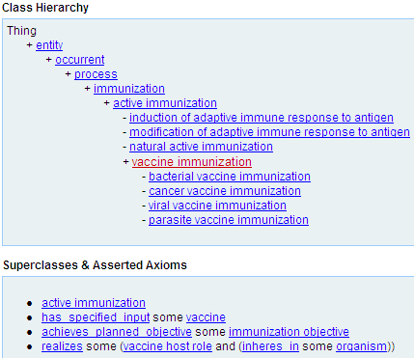
Define and differ VO ‘vaccination’ and ‘vaccine immunization’ with OBI support
Both are processes
Vaccination: administrating vaccine to inside host
Immunization: priming or modifying adaptive immune
response to an antigen.
Some vaccination may not result in immunization

Slide 10
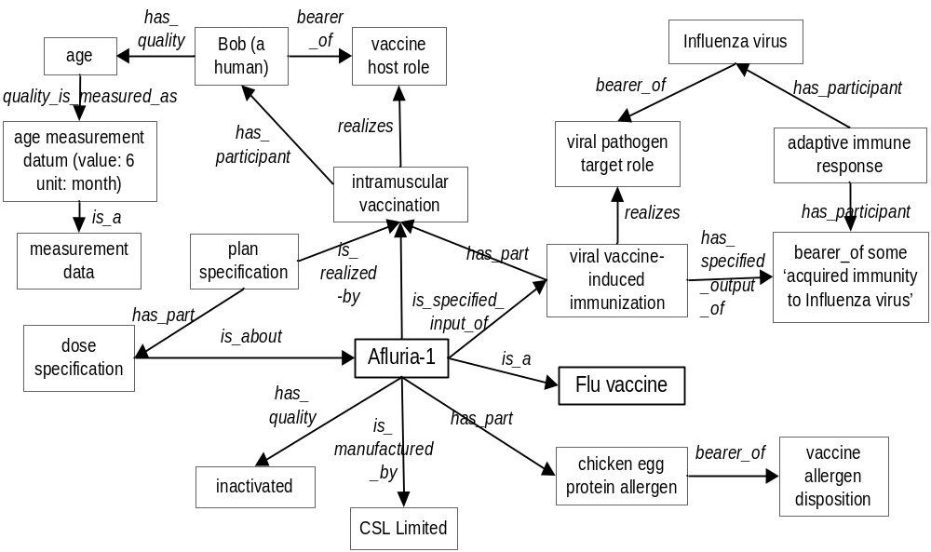
Ex: Model Afluria Influenza Vaccine using VO and OBI

Slide 11
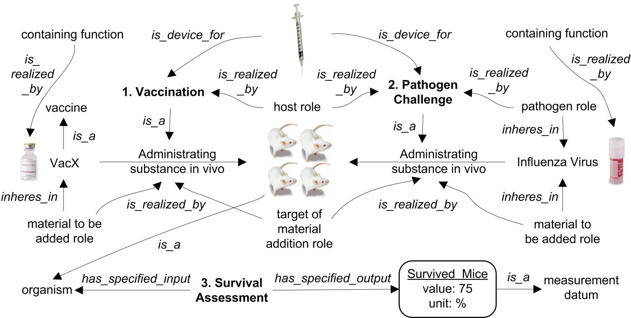
VO and OBI Modeling of
“Vaccine Protection Assay”
3 steps: 1. Vaccination; 2. Pathogen Challenge; 3. Survival Assessment
Reference: Brinkman et al. (2007). Modeling biomedical experimental processes with OBI. Journal of Biomedical Semantics. 2010, 1(Suppl 1):S7. PMID: 20626927.

Slide 12
Outline
You can rely a lot on OBI for development of new ontology, e.g., Vaccine Ontology (VO)
  How to align with OBI and use OBI to represent VO core terms
  How to apply OBI MIREOT strategy and the OntoFox tool to reuse existing OBI terms
  How to use OBI QTT procedure and the Ontorat tool to generate and annotate large numbers of new ontology terms

Slide 13
Question: How to import external terms from large ontologies?
Answer: the MIREOT strategy
Import is better than reinvent existing terms.
Challenge: How for large ontologies (e.g. GO)?
MIREOT: Minimum information to reference external ontology terms
Developed by OBI developers
URL: http://obi-ontology.org/page/MIREOT
Reference: Courtot M, Gibson F, Lister AL, Malone J, Schober D, Brinkman RR, Ruttenberg A. MIREOT: The Minimum Information to Reference an External Ontology Term. ICBO: International Conference on Biomedical Ontology. July 24-26, 2009. Buffalo, New York, USA

Slide 14

OntoFox: A web-based MIREOT implementation
First used in VO development
  Imported 589 classes and 17 object properties from 15 existing ontologies
  E.g. imported 397 terms from NCBITaxon
Popular tool for ontology development, e.g.,
  Reagent Ontology (Matthew Brush)
  Bioassay Ontology (Stephan Schürer)
  Time Event Ontology (Cui Tao)
Reference: Xiang Z, Courtot M, Brinkman RR, Ruttenberg A, He Y. OntoFox: web-based support for ontology reuse. BMC Research Notes. 2010, 3:175. PMID: 20569493.
http://ontofox.hegroup.org/

Slide 15
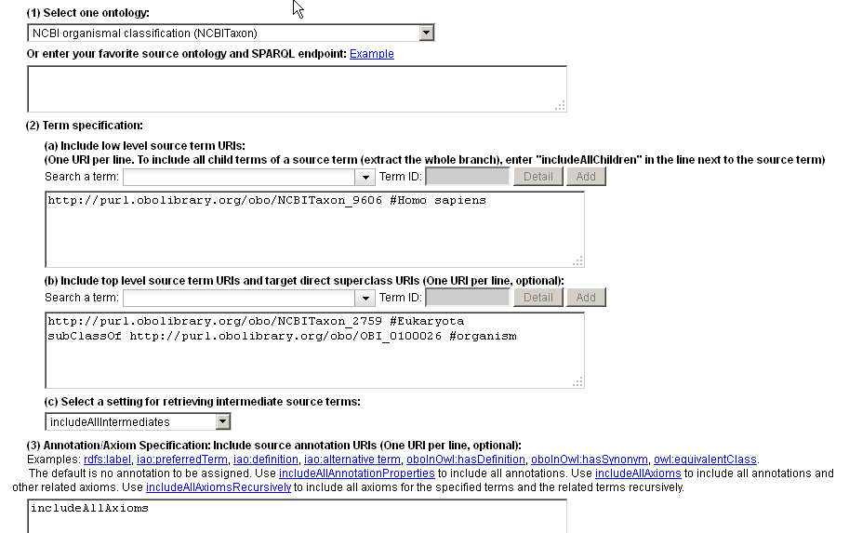
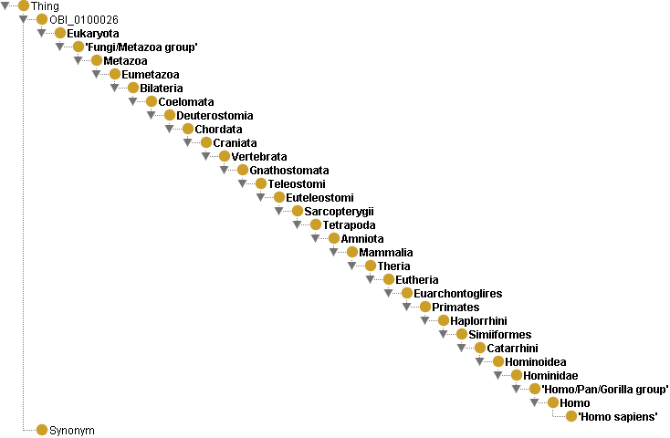
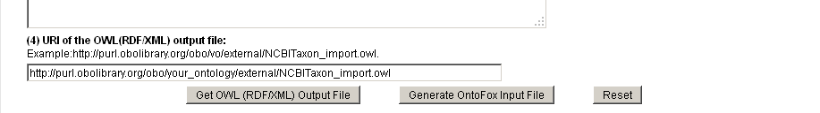
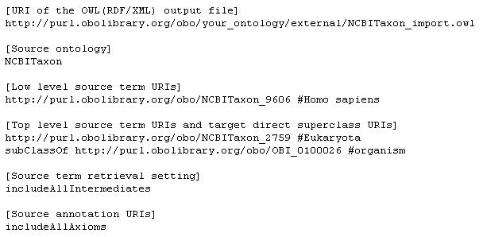
Example: import ‘homo sapiens’ from NCBITaxon
27 middle layers
between human & eukaryote
OntoFox is easy to use and powerful

Slide 16
Selected OntoFox Features
Align retrieved terms with target ontology
  Can use “subClassOf”
Retrieve a whole branch
Retrieval of intermediate layers
  "includeNoIntermediates": no
  "includeComputedIntermediates": closest ancestors of more than one low level source terms.
  "includeAllIntermediates": All
Annotation: none, few, or all
Perform ontology modularization
  Supports full reasoning
  More terms will be extracted
Store the input and rerun later

Slide 17
OntoFox Demo
http://ontofox.hegroup.org
Let’s have a show …

Slide 18
Outline
You can rely a lot on OBI for development of new ontology, e.g., Vaccine Ontology (VO)
  How to align with OBI and use OBI to represent VO core terms
  How to apply OBI MIREOT strategy and the OntoFox tool to reuse existing OBI terms
  How to use OBI QTT procedure and the Ontorat tool to generate and annotate large numbers of new ontology terms

Slide 19
Question: How to generate a large number of ontology terms that have the same design pattern?
Answer: QTT
Manual implementation is time consuming, boring, and easy to make mistakes.
Say, we needed to add >800 licensed animal vaccines to VO, all having the same pattern
  Is licensed
  Is used for one animal species
  Protects against one or more infectious pathogens
  Manufactured by a company
  Have a USDA unique identifier
QQT - Quick Term Templates, by OBI developers
URL:
http://obi-ontology.org/page/Quick_Term_Templates

Slide 20
QTT Implementation
  MappingMaster:
    the first QTT implementation
    a Protégé 3.4 plugin
    does not work in Protégé 4.x
  Ontorat:
    Web-based QTT Implementation
    http://ontorat.hegroup.org/
    Based on Ontology Design Patterns (ODP)
    http://ontologydesignpatterns.org/
  Both generate new ontology terms and axioms
  Both use Manchester OWL syntax
  New for Ontorat:
    Ontorat generates annotations using annotation properties
    Ontorat annotates existing ontology terms
    Design patterns can be saved in Ontorat

Slide 21
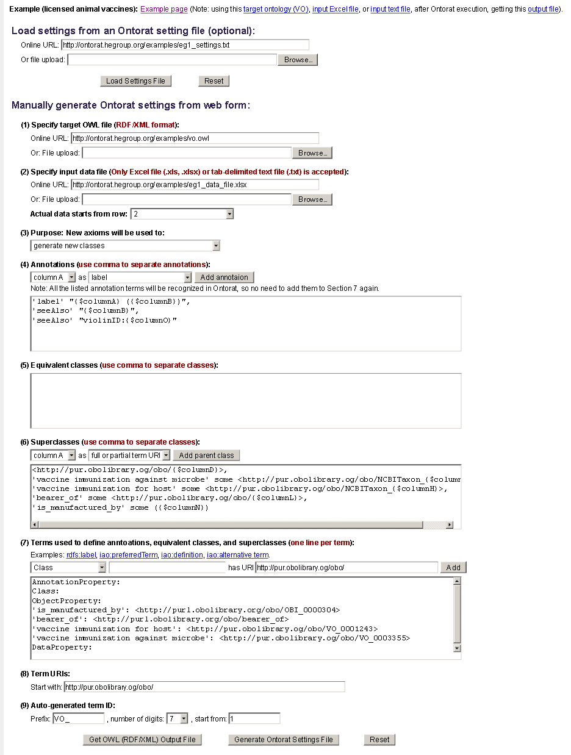
Ontorat Design and Implementation
Ontorat Web Interface:
Input: needs Three Parts for Execution:
Target ontology → to avoid ID duplication
Input data file: Excel or tab-delimited text form
Setting scripts → use Manchester OWL Syntax
(note: settings can be stored and reused)
Output Results:
OWL or Manchester syntax output file
Can be imported/merged to target ontology using Protege-OWL editor
http://ontorat.hegroup.org

Slide 22
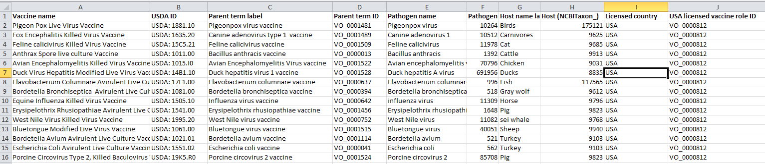


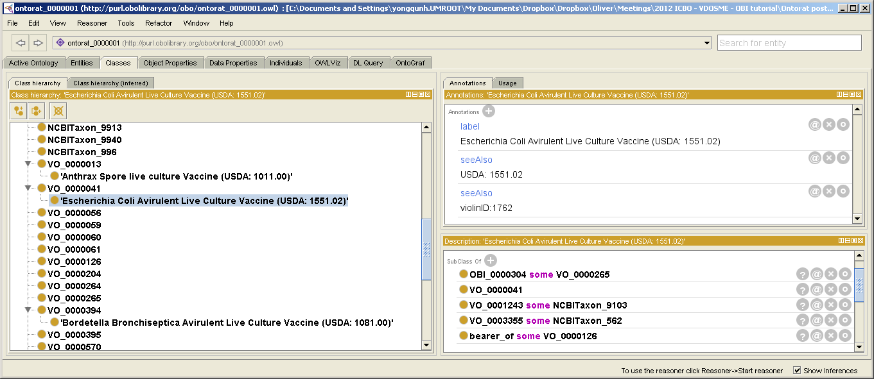
Use case study
(A) Specify target ontology
(B) Specify input data file (in Excel or tab-delimited text)
Use Ontorat to generate new vaccine terms in Vaccine Ontology (VO)
Automatically created new VO terms for ~800 licensed vaccines
Advantages:
quick, user-friendly,
scalable, robust,
save/reuse templates.
(C) Generate settings using Manchester syntax
(D) Execute and retrieve output OWL file
(E) OWL output displayed and merged to target ontology using Protege.

Slide 23
Ontorat Demo
http://ontorat.hegroup.org/
Let’s have a show …

Slide 24
Summary
You can rely a lot on OBI to develop your own ontology
  Align with OBI to represent your specific investigation topics
  Use OntoFox to import individual ontology terms → follow OBI MIEROT strategy
  Use Ontorat to generate and annotate large numbers of new ontology terms → implement OBI QTT procedure

Slide 25
Acknowledgements
Zuoshuang “Allen” Xiang
Yu “Asiyah” Lin
Jie Zheng
Christian Stoeckert
The OBI consortium

